Slide 1
(Polyp) Segmentation
Mohammad Hossein Mazandaranian

Slide 2
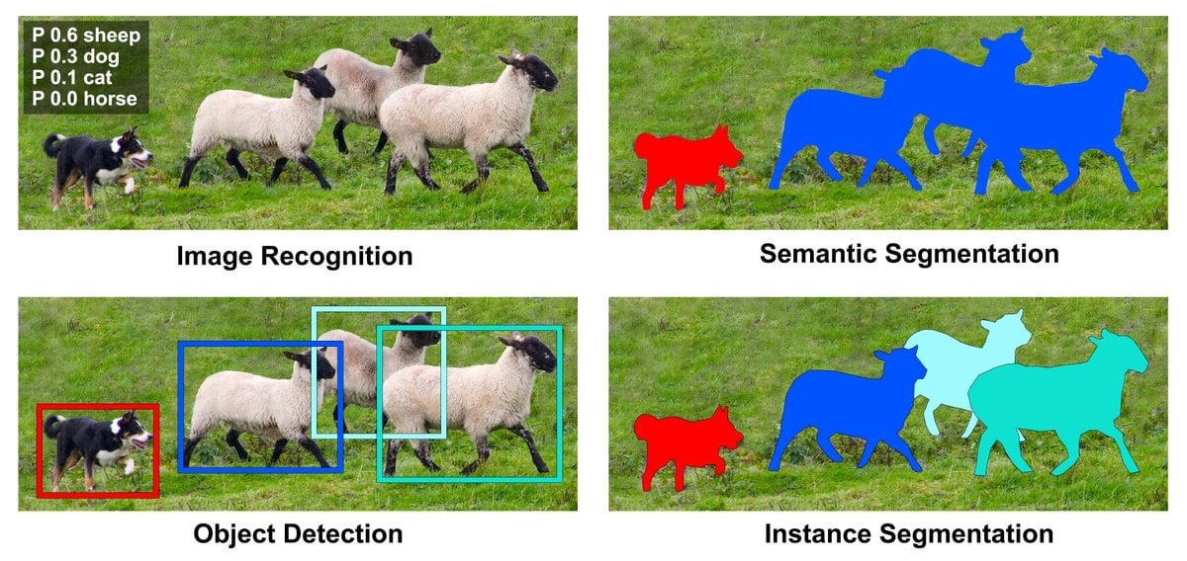

Slide 3
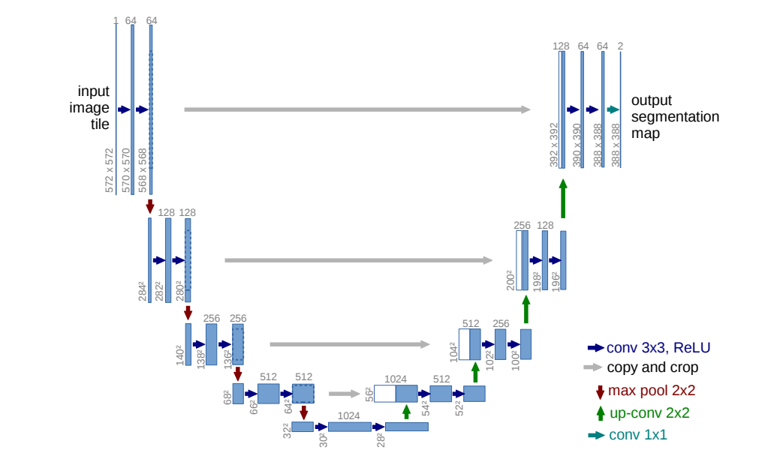
U-net 2015

Slide 4
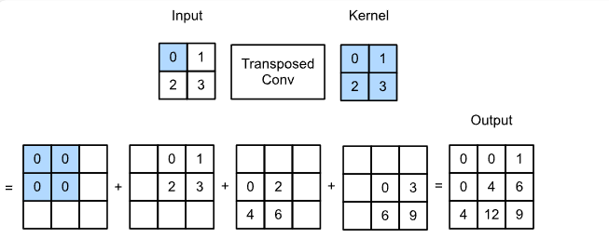

Slide 5
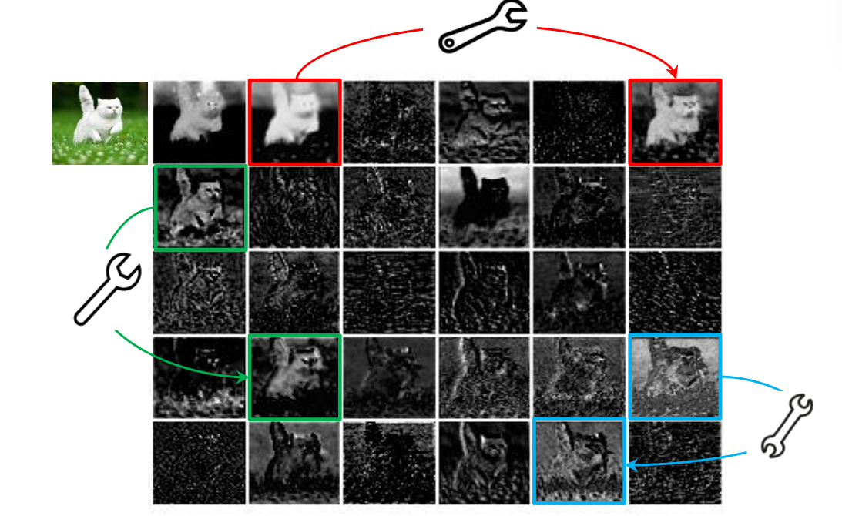
GhostNet 2020 (Ghost Module)

Slide 6
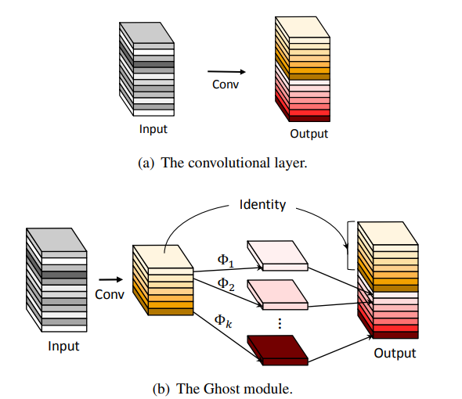

Slide 7
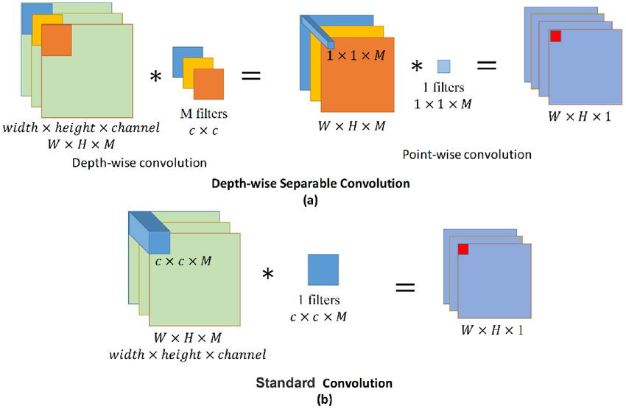
(8x8) x (5x5x1) x (3) = 3,800
(8x8) x (1x1x3) x (256) = 49,152
3,800+49,152 = 53,952
(8x8) x (5x5x3) x (256) = 1,228,800

Slide 8
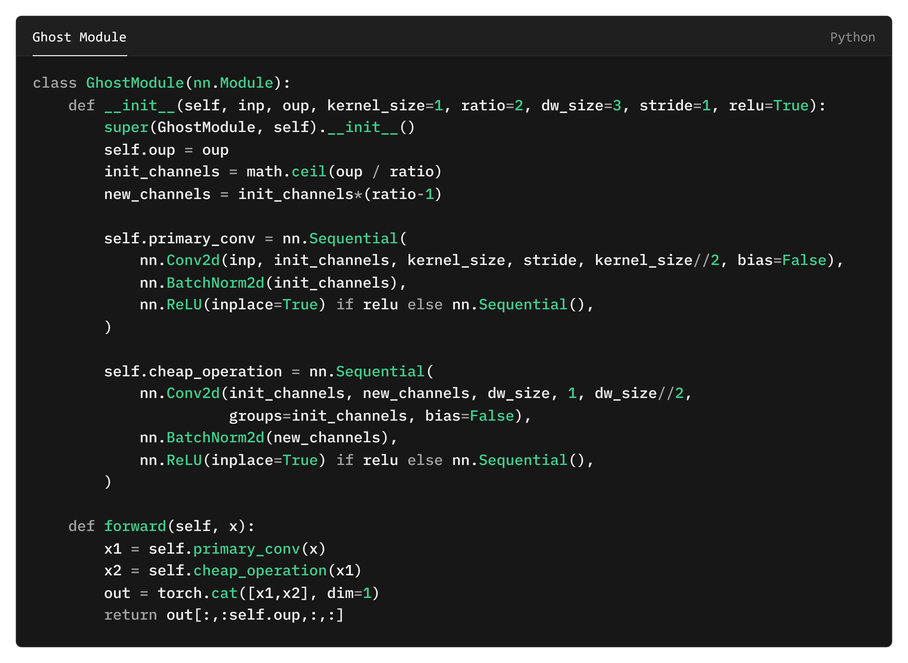

Slide 9
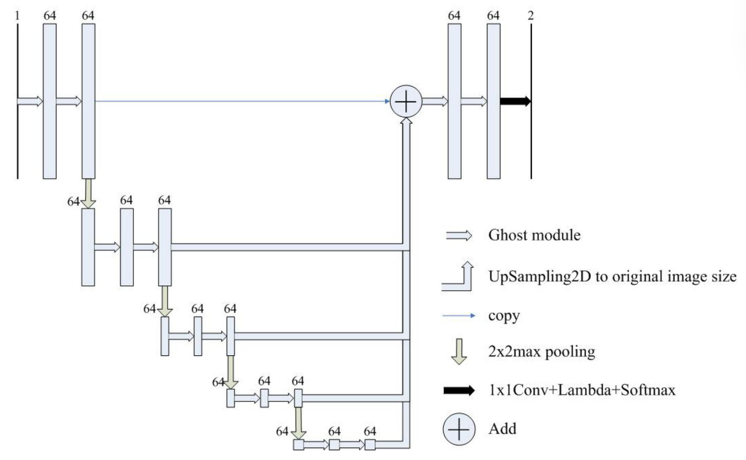
Half-unet (2022)

Slide 10
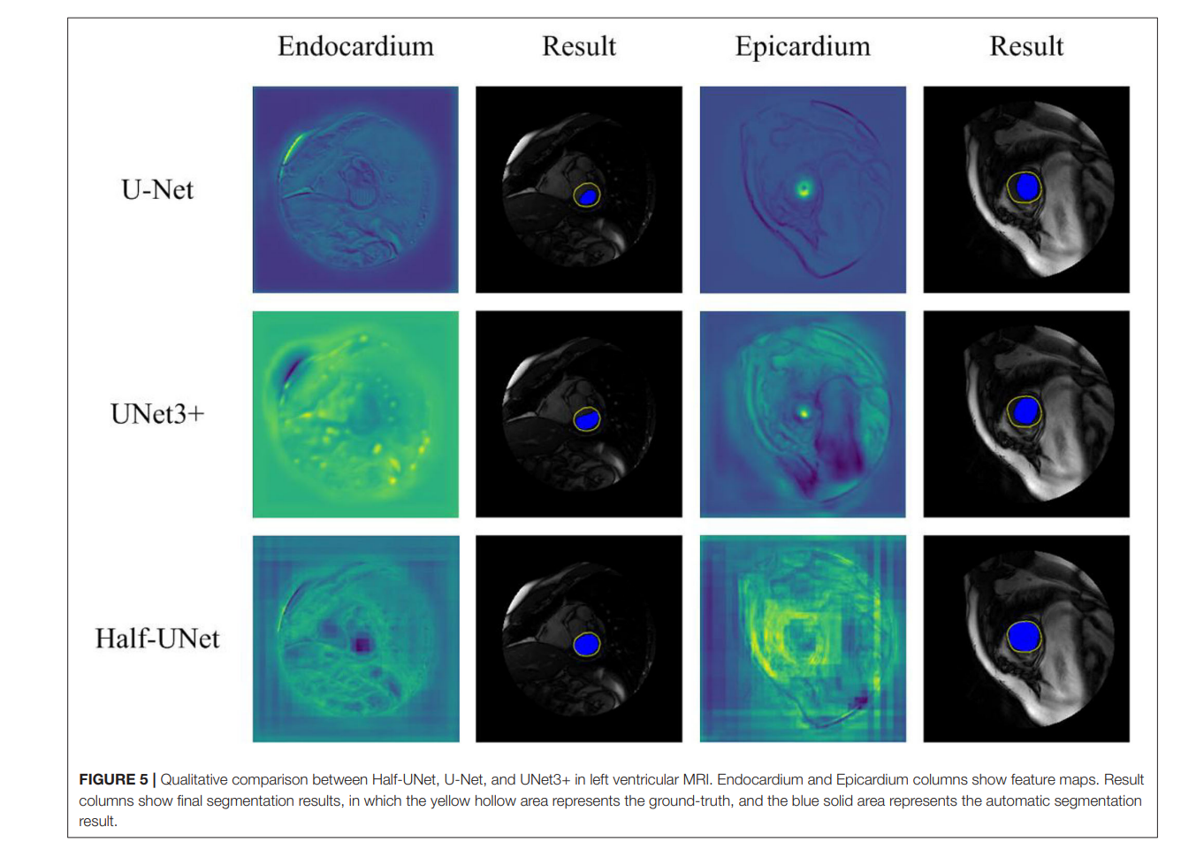

Slide 11
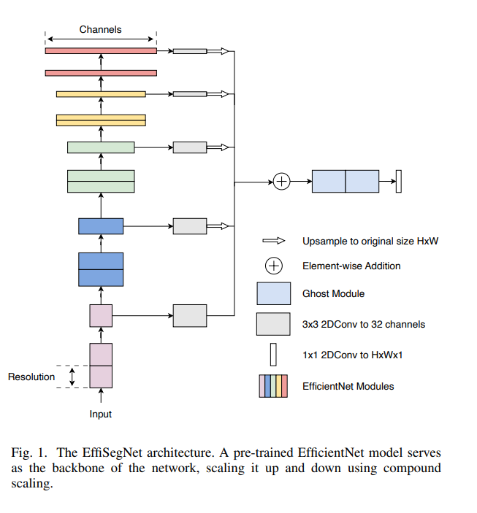
EffiSegNet (2024)

Slide 12
